Slide 1

Part 4
Basics of JavaScript

Slide 2
Contents
4.1 Overview of JavaScript
4.2 Object-based and JavaScript
4.3 General syntactic characteristic
4.4 Primitives, operations, and expressions
4.5 Screen output and keyboard input
4.6 Control statements
4.7 Object creation and modification
4.8 Arrays
4.9 Functions
4.10 An example
4.11 Constructors

Slide 3
4.1 Overview of JavaScript: Origins
Origin: developed by Netscape, supported by almost all Web browsers.
JavaScript Components
Core:
The heart of the language: operators, expressions, etc.
Client-side:
Library of objects supporting browser control and user interaction such as button, form, etc.
Server-side:
Library of objects that support use in web servers

Slide 4
4.1 Uses of JavaScript
Client-side JavaScript is used far more frequently than server-side JavaScript.
Client-side JavaScript is embedded in HTML
Example 4-1.html.

Slide 5
4.1 Uses of JavaScript
Advantages:
(1)Provide an alternative to server-side programming.
Servers are often overloaded
Client processing has short reaction time
(2)JavaScript can interact with the internal model of the web page (Document Object Model, DOM).
(3)JavaScript provides more complex user interfaces.
Resources
http://www.protopage.com/ is an interesting example for creating your personal pages.
http://300mb.us is also a useful self-publishing sites.

Slide 6
4.1 Event-driven Computation
Users actions, such as mouse clicks and key presses, are referred to as events.
JavaScript task: The main task of JavaScript programs is to respond to events.
For example, a JavaScript program could validate data in a form before it is submitted to a server.

Slide 7
4.1 XHTML/JavaScript Documents
When JavaScript is embedded in an XHTML document, the browser must interpret it.
JavaScript positions: Two locations of JavaScript serve different purposes.
JavaScript in the head element contains functions which will be called from other locations.
JavaScript in the body element will be executed once as the page is loaded.
Example 4-2.html

Slide 8
4.2 Object Based and JavaScript
JavaScript is object-based
JavaScript defines objects that encapsulate both data and methods.
However, JavaScript does not have true inheritance nor subtyping.

Slide 9
4.2 JavaScript Objects
Objects are collections of properties, which are either data properties or method properties
Data properties are either primitive values or references to other objects.
Method property is often referred to as methods or functions.
The root object in JavaScript is Object, which is the ancestor of all objects in a JavaScript program.
Object has no data properties, but several method properties.

Slide 10
4.3 General Syntactic Characteristics
Directly embedded
<script type=“text/javascript”>
…Javascript here…
</script>
Indirect reference
<script type=“text/javascript” src=“tst_number.js”>
</script>
This is the preferred approach.
Refer to 4-indirect.html
Note: the double-quotation marks must be input in English format.

Slide 11
4.3 General Syntactic Characteristics
Identifiers or names
Start with dollar sign($), underscore(_) or a letter
Continue with $, _, letter or digit
Case sensitive
25 Reserved words (refer to table 4.1 in pp. 143)
Comments
//
/* … */

Slide 12
4.3 Statement Syntax
Statements are terminated with a semicolon.
However, the interpreter will insert the semicolon if it is missing at the end of a line and the statement seems to be complete.
Can be a problem:
return
x;
If a statement must be continued to a new line, make sure that the first line does not make a complete statement by itself.

Slide 13
4.4.1 Primitive Types
Five primitive types
Number
String
Boolean
Undefined
Null

Slide 14
4.4.1 Primitive Types
Three objects correspond to the first three primitive types.
Number, String, Boolean
Each wrapper objects not only contains a property storing the primitive value, but also contain methods and properties to use the values of the primitive types.
Primitive values are coerced to the wrapper objects as necessary, and vice-versa.

Slide 15
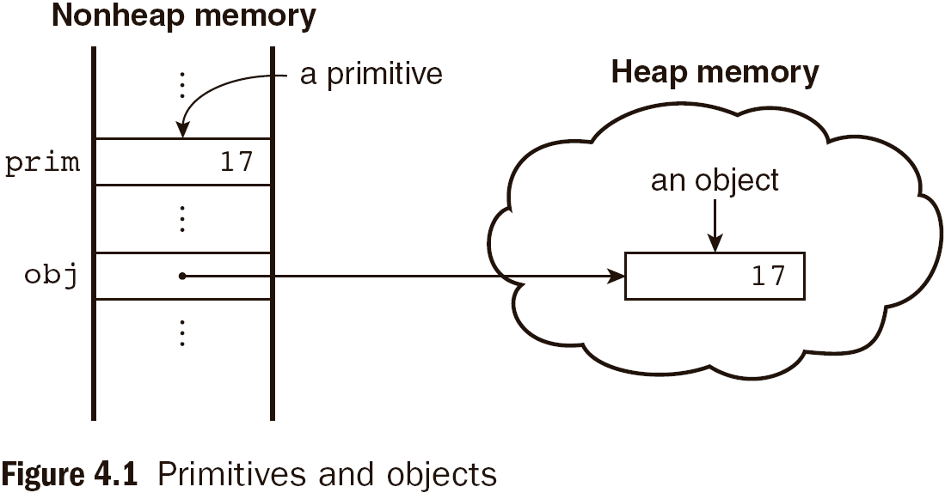
4.4.1 Primitive and Object Storage

Slide 16
4.4.2 Numeric and String Literals
Number values are represented internally as double-precision floating-point values.
Number literals can be either integer or float.
Float values may have a decimal and an exponent.
A String literal is delimited by single or double quotes.
There is no difference between single and double quotes.
Certain characters may be escaped in strings
\’ or \” to use a quote in a string delimited by the same quotes, \\ to use a literal backslash
The empty string ‘’ or “” has no characters.

Slide 17
4.4.3 Boolean Primitive Types
Null
A single value, null
null is a reserved word
A variable that is used but has not been explicitly declared or assigned a value has a null value.
Using a null value usually causes an error.

Slide 18
4.4.3 Other Primitive Types
Undefined
A single value, undefined
However, undefined is not a reserved word.
The value of a variable that is explicitly declared, but not assigned a value.
Boolean
Two values: true and false

Slide 19
4.4.4 Declaring Variables
Type: JavaScript is dynamically typed. That is to say, variables do not have declared types.
A variable can hold different types of values at different times during program execution.
Declaring method: A variable is declared using the keyword var or assigning it a value:
var counter,
index,
pi = 3.14159265,
quarterback = "Elway",
stop_flag = true;

Slide 20
4.4.5 Numeric Operators
Standard arithmetic
+ * - / %
Increment and decrement
++ --
Increment and decrement differ in effect when it is used before and after a variable.
Assume that a initially has the value 7,
(++a) * 3 has the value 24
(a++) * 3 has the value 21
a has the final value 8 in either case.

Slide 21
4.4.5 Numeric Operator
var a = 2,
b = 4,
c,
d;
c = 3 + a * b;
// * is first, so c is now 11 (not 24)
d = b / a / 2;
// / associates left, so d is now 1 (not 4)

Slide 22
4.4.6 The Math Object
Provides a collection of properties and methods on Number objects.
This includes the trigonometric functions such as
sin and cos
floor
round
max
When used, the methods must be qualified as Math.sin(x).

Slide 23
4.4.7 The Number Object
Number object includes a collection of useful properties that has constant values. (Table 4.3 on pp.149)
Properties
MAX_VALUE
NaN
POSITIVE_INFINITY
NEGATIVE_INFINITY
PI
Operations resulting in errors return NaN
Use isNaN(a) to test if a is NaN.
toString() method converts a number to string.

Slide 24
4.4.8 String Catenation
The operator + denotes the string catenation operation.
In many cases, other types are automatically converted to string.
For example:
var first=“a tiger”;
var last=first+ “is big”;

Slide 25
4.4.9 Implicit Type Conversion
JavaScript attempts to convert values in order to be able to perform operations.
“August ” + 1977 causes the number to be converted to string and a concatenation is to be performed.
7 * “3” causes the string to be converted to a number and a multiplication is to be performed.

Slide 26
4.4.10 Explicit Type Conversion
Explicit conversion of string to number.
Number(aString)
aString – 0
parseInt and parseFloat try to find the integer or float from the beginning of a string. If failed, NaN is returned.
For example: parseFloat(“10”)

Slide 27
4.4.11 String Properties and Methods
One property: length
Note to Java programmers, this is not a method!
For example
var str=“George”;
var len=str.length;
Character positions in strings begin at index 0 (next slide).

Slide 28
4.4.11 String Methods（pp.152 Table 4.4）
Method | Parameters | Result
charAt() | A number | Returns the character in the String object that is at the specified position.
indexOf() | One-character string | Returns the position in the String object of the parameter.
substring() | Two numbers | Returns the substring of the String object from the first parameter position to the second.
toLowerCase() | None | Converts any uppercase letters in the string to lowercase.
toUpperCase() | None | Converts any lowercase letters in the string to uppercase.

Slide 29
4.4.11 String Methods
Please refer to the example in pp.152

Slide 30
4.4.12 The typeof Operator
Two syntactic forms
typeof x
typeof(x)
Returns “number” or “string” or “boolean” for primitive types
Returns “object” for an object or null.

Slide 31
4.4.13 Assignment Statements
Plain assignment indicated by =
Compound assignment with
+= -= /= *= %= …
a += 7 means the same as a = a + 7

Slide 32
4.4.14 The Date Object
A Date object represents a time stamp, a point in time.
A Date object is created with the new operator
var now= new Date();
This creates a Date object for the time at which it was created.
Please refer to the functions of Table 4.5 on pp.154

Slide 33
4.5 Screen Output and Keyboard Input
The Window object represents the window in which the script is being displayed.
The Document object represents the document being displayed using DOM.
Window has two properties
window refers to the Window object itself.
document refers to the Document object.
Note: The Window object is the default object for JavaScript. So properties and methods may be used without the class name.

Slide 34
4.5 Screen Output and Keyboard Input
The write method of the document object write its parameters to the browser window.
The output is interpreted as HTML by the browser.
If a line break is needed in the output, interpolate <br/> into the output.

Slide 35
4.5 The alert Method
The alert method opens a dialog box with a message.
The output of the alert is not XHTML, so use new lines \n rather than <br/>
alert("The sum is:" + sum +"\n");

Slide 36
4.5 The confirm Method
The confirm method displays a message provided as a parameter.
The confirm dialog has two buttons: OK and Cancel.
If the user presses OK, true is returned.
If the user presses Cancel, false is returned.
var question =
confirm("Do you want to continue this download?");

Slide 37
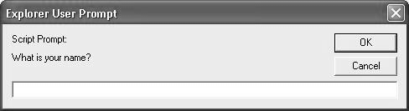
4.5 The prompt Method
This method displays its string argument in a dialog box.
A second argument provides a default content for the user entry area.
The dialog box has an area for the user to enter text.
The method returns a String with the text entered by the user.
name = prompt("What is your name?", "");

Slide 38
4.5 Example of Input and Output
roots.html

Slide 39
4.6.1 Control Expressions
A control expression has a Boolean value.
An expression with a non-Boolean value used in a control statement will have its value converted to Boolean automatically.
Comparison operators (table 4.6, pp.158)

Slide 40
4.6.1 Control Expressions
A control expression has a Boolean value.
An expression with a non-Boolean value used in a control statement will have its value converted to Boolean automatically.
Comparison operators (table 4.6, pp.158)
== != < <= > >=
=== compares both the value and the data type
3 == ‘3’ is true due to automatic conversion
3 === ‘3’ is false
Boolean operators
&& || !

Slide 41
4.6.2 Selection Statements
The if and if-else are similar to those in other programming languages such as C/C++ or Java.
For example:
if(a>b)
document.write(“a is greater than b <br/>”);
else
{
a=b;
document.write(“a is less than or equal to b”);
}

Slide 42
4.6.3 switch Statement Syntax
switch (expression)
{
case value_1:
// statement(s)
case value_2:
// statement(s)
...
default:
// statement(s)
}

Slide 43
4.6.3 switch Statement Semantics
The expression is evaluated. The value of the expression is compared to the value in each case in turn.
If no case matches, execution begins at the default case.
Otherwise, execution continues with the statement following the case.
Execution continues until either the end of the switch or a break statement is met.

Slide 44
4.6.4 Loop Statements
Loop statements in JavaScript are similar to those in C/C++/Java.
while
while (control expression)
statement or compound statement
for
for (initial expression; control expression; increment expression)
statement or compound statement
do/while
do statement or compound statement
while (control expression)

Slide 45
4.6.4 while Statement
while (control expression)
statement or compound statement
The control expression is evaluated. If the control expression is true, the statement is executed.
These two steps are repeated until the control expression becomes false.
At that point the while statement is finished.

Slide 46
4.6 for Statement
for (initial expression; control expression; increment expression)
statement or compound statement
The initial expression is evaluated initially.
The control expression is evaluated for every iteration.
If the control expression is true, the statement is executed.
Then the increment expression is evaluated.
The previous three steps are repeated as long as the control expression remains true.
When the control expression becomes false, the loop finishes.

Slide 47
4.6 do/while Statement
do statement or compound statement
while (control expression)
The statement is executed.
The control expression is evaluated.
If the control expression is true, the previous steps are repeated.
This continues until the control expression becomes false.
At that point, the statement execution is finished.

Slide 48
4.6.4 date.html Example (pp.163)
Displays the components of a Date object
getDate(),getDay(),getMonth(),getTime()
Uses Date objects to time a calculation
start and end object
Illustrates an example of loop

Slide 49
Exercise
Input: Three numbers, using prompt to get each
Output: The largest of the three numbers
Hint: Use the predefined function Math.max()
Tips: Math.max() can accept more parameters than two simultaneously.

Slide 50
4.7 Object Creation and Modification (pp.165)
The new expression is used to create an object.
This includes a call to a constructor.
The constructor creates and initializes all properties of the object.
Properties of an object are accessed using a dot notation: object.property.
Properties are not variables, so they are not declared.
The number of properties of an object may vary dynamically in JavaScript.

Slide 51
4.7 Dynamic Properties
Create my_car and add some properties
// Create an Object my_car
var my_car = new Object();
// Create and initialize the make property
my_car.make = "Ford";
// Create and initialize model
my_car.model = "Contour SVT";
The delete operator can be used to delete a property from an object.
delete my_car.model

Slide 52
4.7 The for-in Loop
Syntax
for (identifier in object)
statement or compound statement
The loop lets the identifier take on each property in turn in the object.
Printing the properties in my_car:
for (var prop in my_car)
document.write("Name: ", prop, "; Value: ",
my_car[prop], "<br />");
Result:
Name: make; Value: Ford
Name: model; Value: Contour SVT

Slide 53
4.8 Arrays
Arrays are lists of elements indexed by a numerical value.
Array indexes in JavaScript begin with 0.
Arrays can be modified in size even after they have been created.

Slide 54
4.8.1 Array Object Creation
Arrays can be created using the new Array() method.
new Array with one parameter creates an empty array of the specified number of elements.
new Array(10)
new Array with two or more parameters creates an array with the specified parameters as elements.
new Array(10, 20)
Literal arrays can be specified using square brackets to include a list of elements.
var alist = [1, “ii”, “gamma”, “4”];
Elements of an array do not have to be of the same type.

Slide 55
4.8.2 Characteristics of Array Objects
The length of an array can be set at any time. my_List.length=1000;
Assignment to an index greater than or equal to the current length simply increases the length of the array.
my_List[1000]=5;
Only assigned elements of an array occupy space.
Suppose an array were created using new Array(200)
Suppose only elements 150 through 174 were assigned values
Only the 25 assigned elements would be allocated storage, the other 175 would not be allocated storage.

Slide 56
4.8.2 Example insert_names.html
This example shows the dynamic nature of arrays in JavaScript.

Slide 57
4.8.3 Array Methods (pp.169)
join converts all the elements into a string(by copy).
var names = new Array["Mary", "Murray", "Murphy", "Max"];
var name_string = names.join(" : ");
reverse does what your expect (by reference).
sort coerces the elements in the array to strings and sort them. (by reference)
names.sort();
concat catenates its actual parameters to the array (by copy).
var names = new Array["Mary", "Murray", "Murphy"];
var new_names = names.concat(“Moo”, “Meow”);

Slide 58
4.8.3 Array Methods
slice fetches a subsequence of the array
var list = [2, 4, 6, 8, 10];
var list2 = list.slice(1,3);
var list = ["Bill", "Will", "Jill", "dill"];
var listette = list.slice(2);

Slide 59
4.8.3 Two-dimensional Arrays
A two-dimensional array in JavaScript is an array of arrays.
This need not even be rectangular shaped: different rows could have different length.
Example nested_arrays.html illustrates two-dimensional arrays.

Slide 60
4.9 Function Fundamentals
Function definition syntax
A function definition consists of a header followed by a compound statement.
A function header:
function function-name(optional-formal-parameters)
return statements
A return statement causes a function to cease execution and the control to pass to the caller.
A return statement may include a value sent to caller.
A return statement without a value implicitly returns undefined.

Slide 61
4.9 Function Fundamentals
Function call syntax
Function name followed by parentheses and any actual parameters.
Function call may be used as an expression or part of an expression.
Functions must be defined before use in the page header.

Slide 62
4.9 Functions are Objects
Functions are objects in JavaScript
Functions may, therefore, be assigned to variables and to object properties.
Example
function fun() {
document.write("This surely is fun! <br/>");
}
ref_fun = fun; // Now, ref_fun refers to the fun object
fun(); // A call to fun
ref_fun(); // Also a call to fun

Slide 63
4.9.2 Local Variables
The scope of a variable is the range of statements over which it is visible.
A variable not declared using var has global scope, visible in the entire document, even if implicitly used inside a function definition
A variable declared with var outside a function definition has global scope.
A variable declared with var inside a function definition has local scope, visible only inside the function definition
If a global variable has the same name, it is hidden inside the function definition

Slide 64
4.9.3 Parameters
Parameters named in a function header are called formal parameters.
Parameters used in a function call are called actual parameters.

Slide 65
4.9.3 Parameters
JavaScript checks neither the type nor number of parameters in a function call.
Formal parameters have no type specified.
Extra actual parameters are ignored.
If there are fewer actual parameters than formal parameters, the extra formal parameters remain undefined.
This is typical of scripting languages.
A property array named arguments holds all of the actual parameters, whether or not there are more of them than there are formal parameters.
Example para.html

Slide 66
4.11 Constructors
Constructors are functions that create and initialize properties for new objects
A constructor uses the keyword this in the body to refer to the object being initialized
Object methods are properties that refer to the functions
A function to be used as a method may use the keyword this to refer to the object on which it is acting
Example car_constructor.html

Slide 67
Homework
pp.191
4.11

